Slide 1
Word Level Property Directed Reachability
杨柳 20/10/16

Slide 2
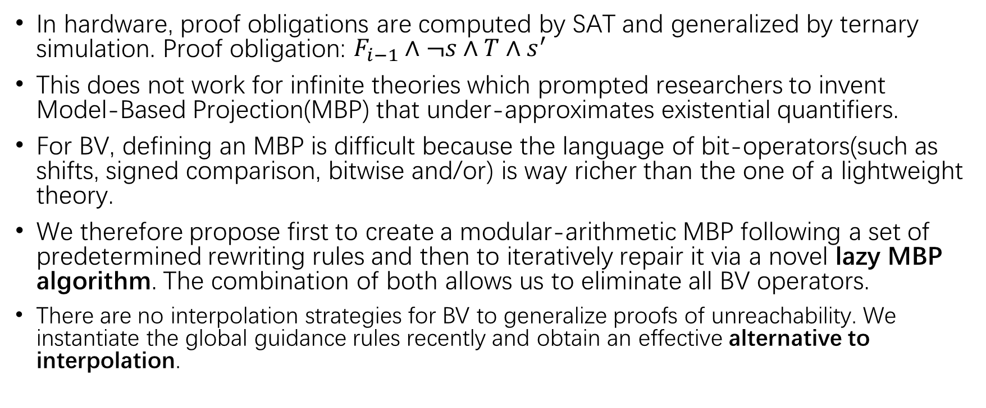
Introduction
In hardware, proof obligations are computed by SAT and generalized by ternary simulation. Proof obligation: $F_{i−1}∧¬s∧T∧s^{′}$
This does not work for infinite theories which prompted researchers to invent Model-Based Projection(MBP) that under-approximates existential quantifiers.
For BV, defining an MBP is difficult because the language of bit-operators(such as shifts, signed comparison, bitwise and/or) is way richer than the one of a lightweight theory.
We therefore propose first to create a modular-arithmetic MBP following a set of predetermined rewriting rules and then to iteratively repair it via a novel lazy MBP algorithm. The combination of both allows us to eliminate all BV operators.
There are no interpolation strategies for BV to generalize proofs of unreachability. We instantiate the global guidance rules recently and obtain an effective alternative to interpolation.

Slide 3
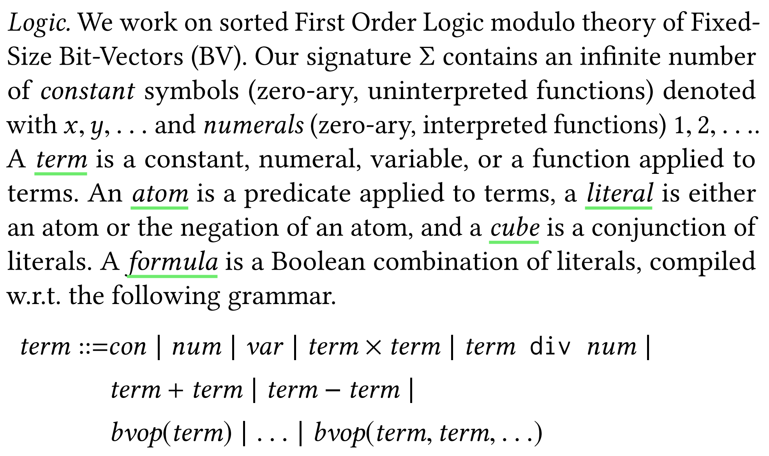
Bit-Vectors Theory

Slide 4
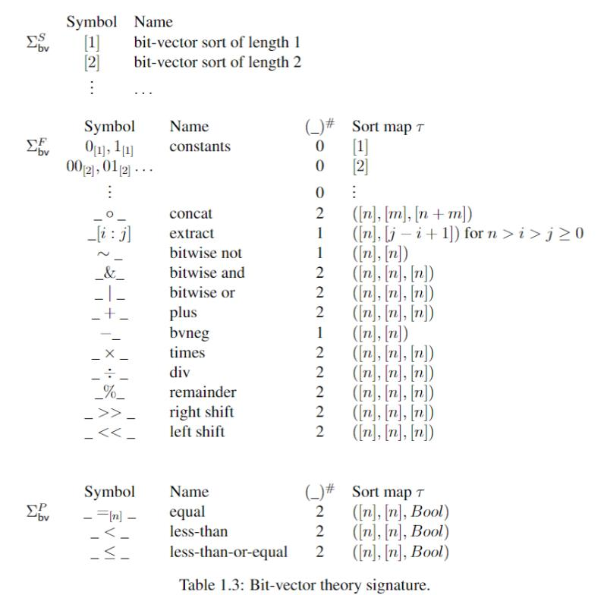
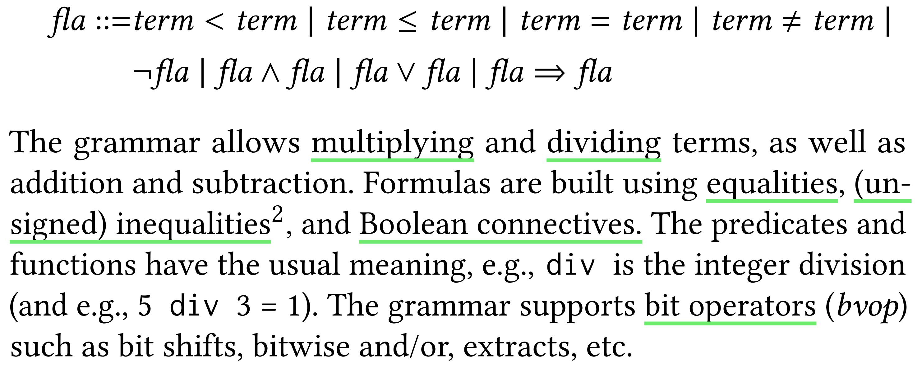
Bit-Vectors Theory

Slide 5
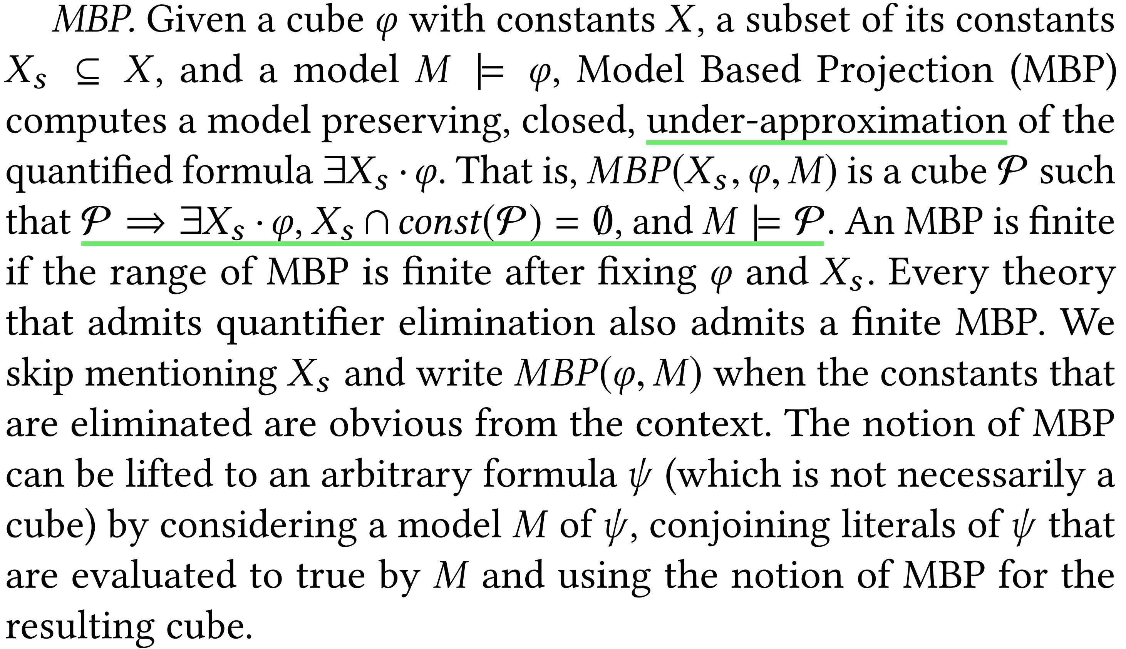
Model Based Projection

Slide 6
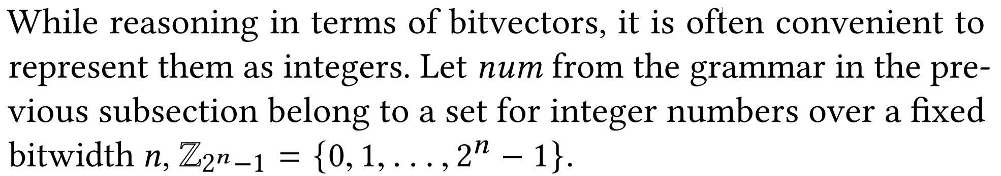
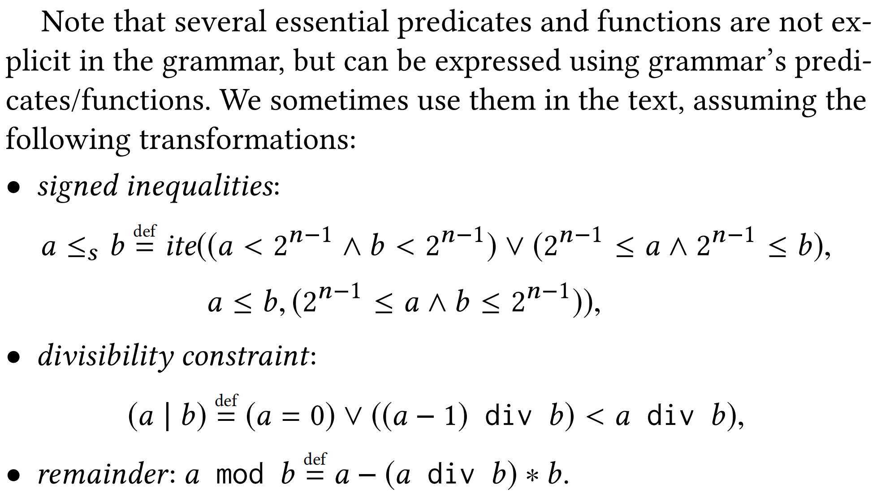
Modular linear arithmetic: a part of the signature of BV

Slide 7
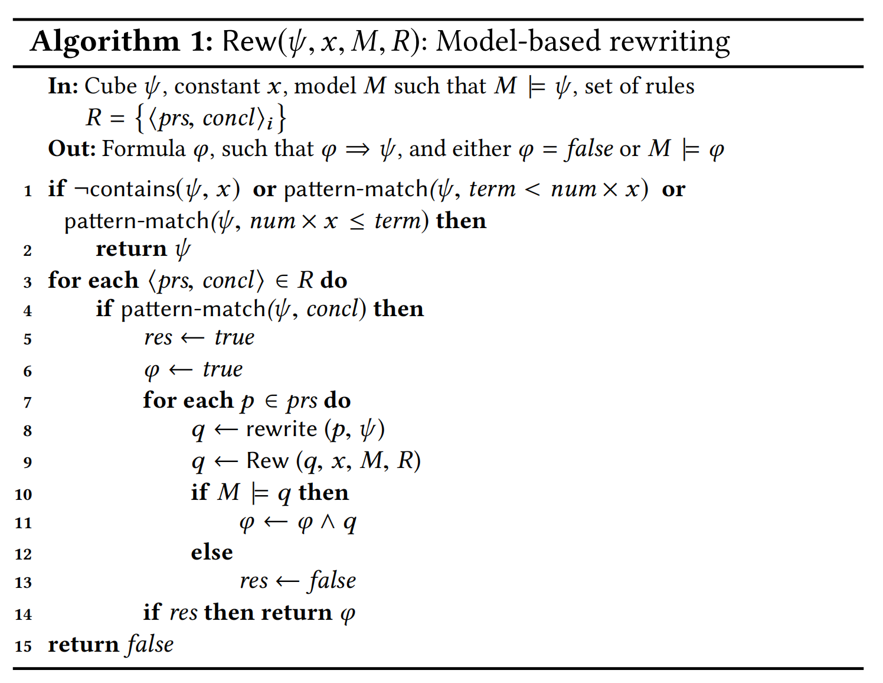
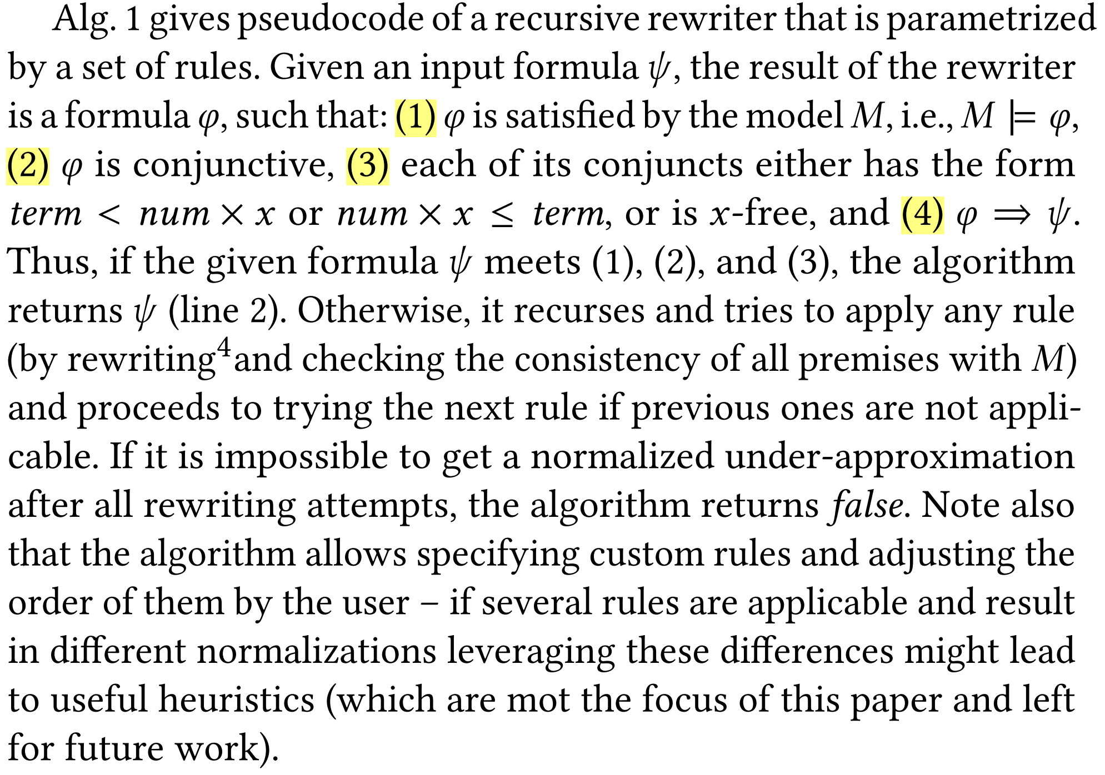

Defining ${MBP}_{ℤ}$:normalization rules for modular arithmetic

Slide 8
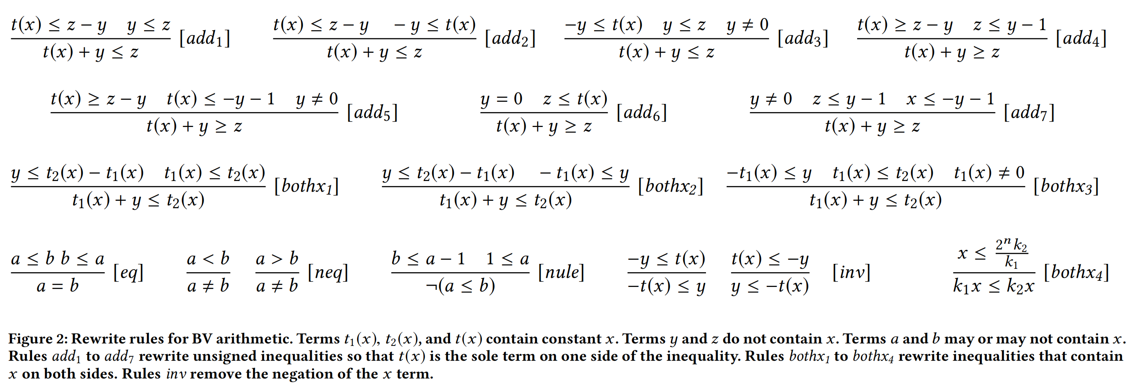
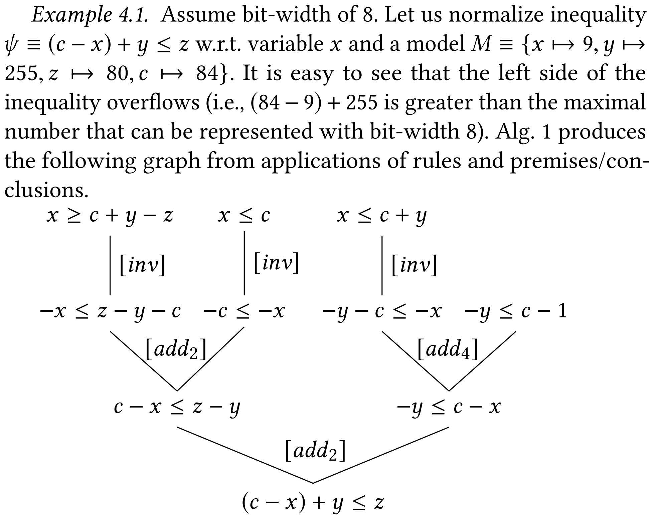
Defining ${MBP}_{ℤ}$:normalization rules for modular arithmetic

Slide 9
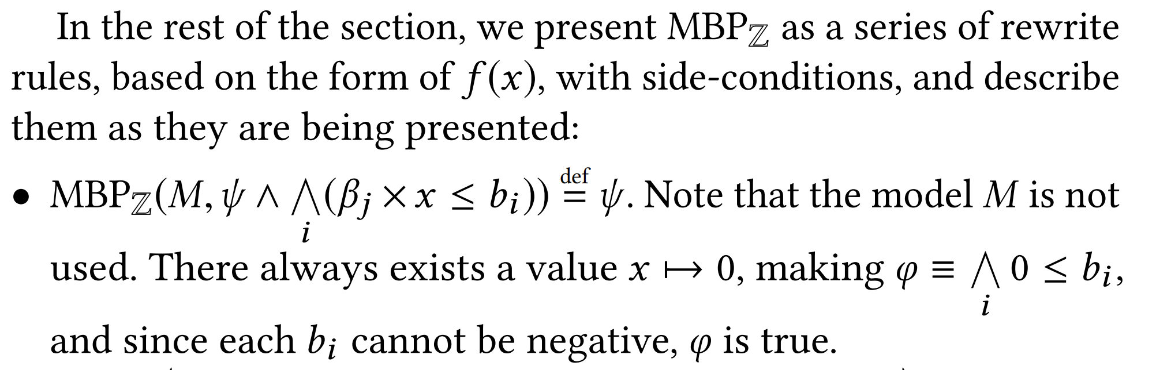
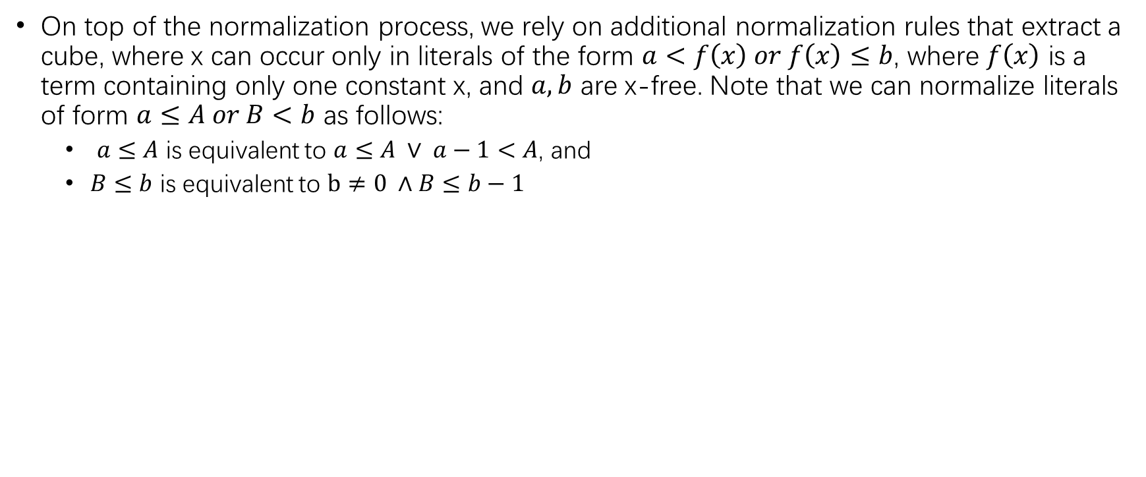

Defining ${MBP}_{ℤ}$
On top of the normalization process, we rely on additional normalization rules that extract a cube, where x can occur only in literals of the form $a<f\left(x\right) or f\left(x\right)≤b$, where $f\left(x\right)$ is a term containing only one constant x, and $a,b$ are x-free. Note that we can normalize literals of form $a≤A or B<b$ as follows:
$a≤A$ is equivalent to $a≤A ∨ a−1<A$, and
$B≤b$ is equivalent to $b≠0 ∧B≤b−1$

Slide 10
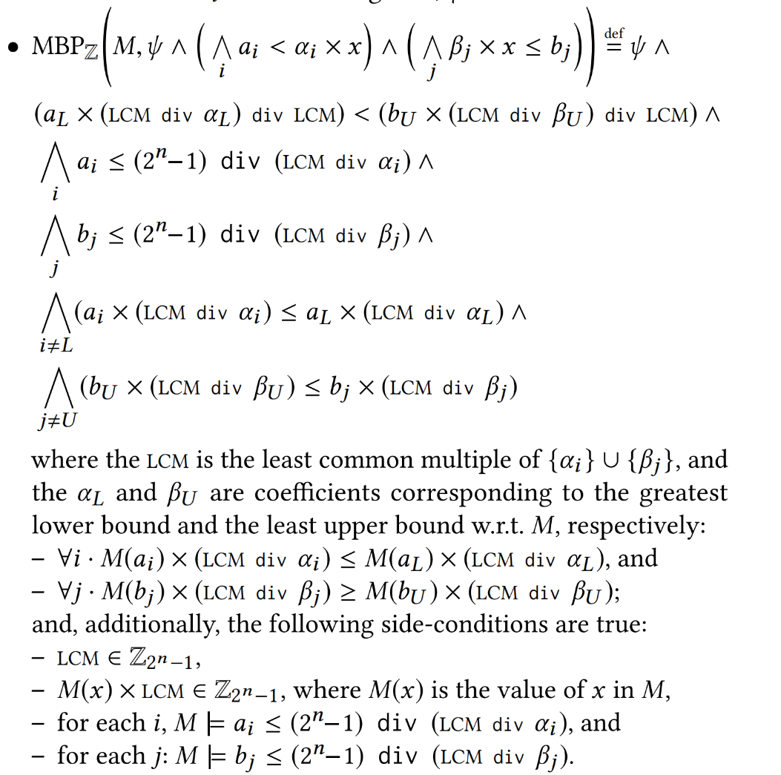
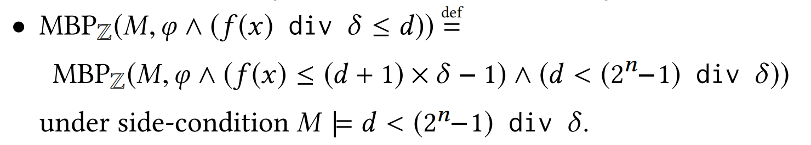
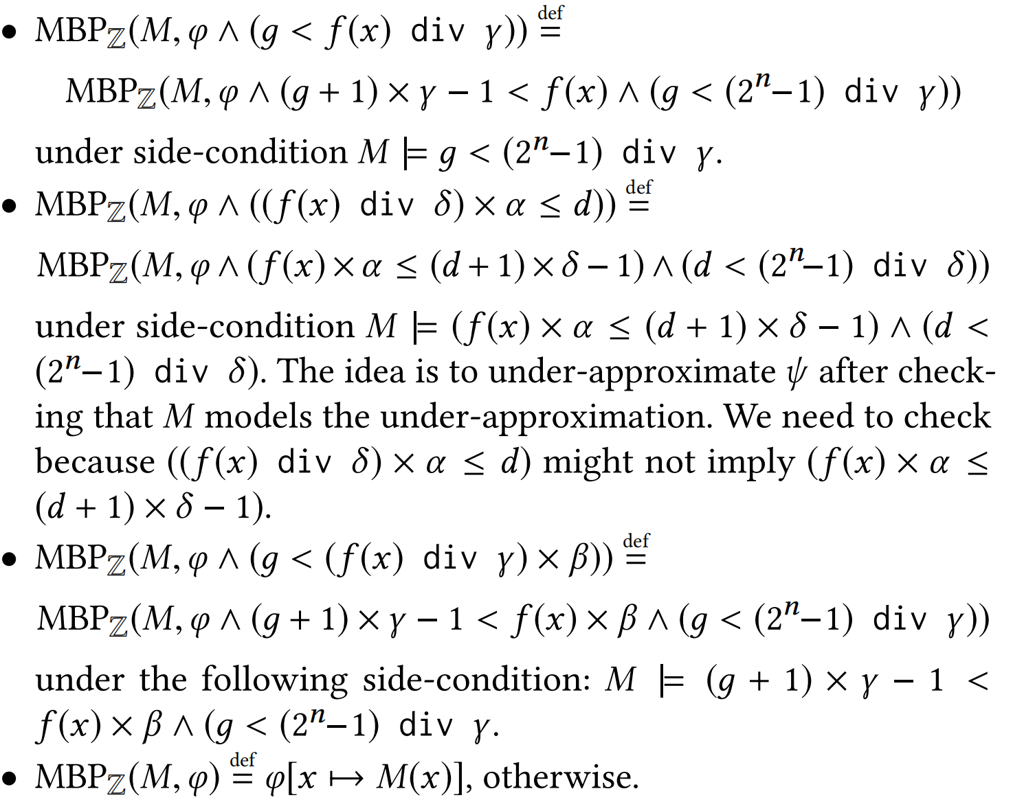
Defining ${MBP}_{ℤ}$

Slide 11
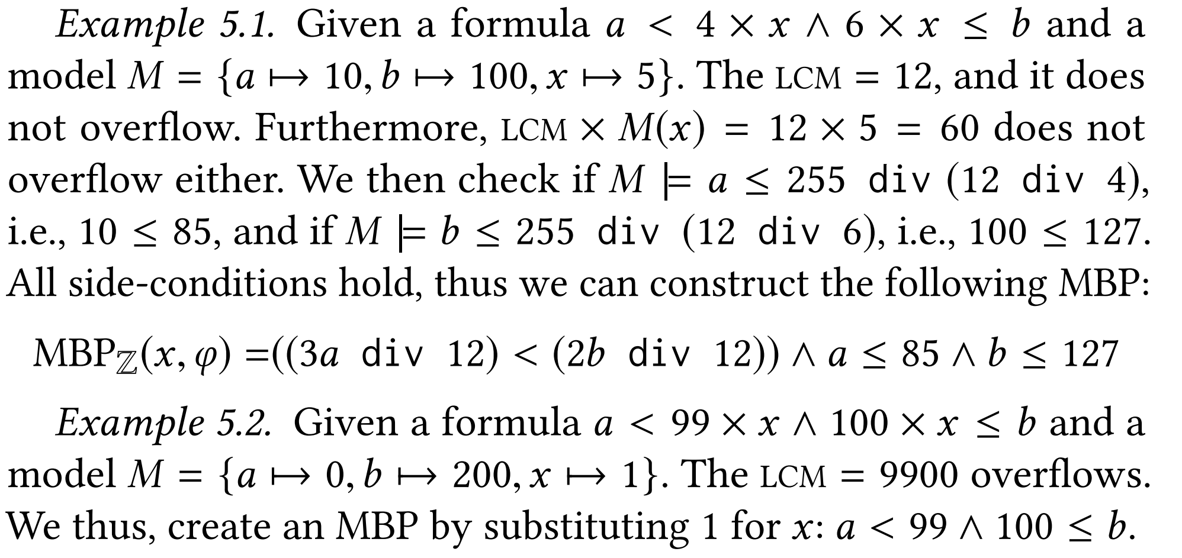
Defining ${MBP}_{ℤ}$

Slide 12
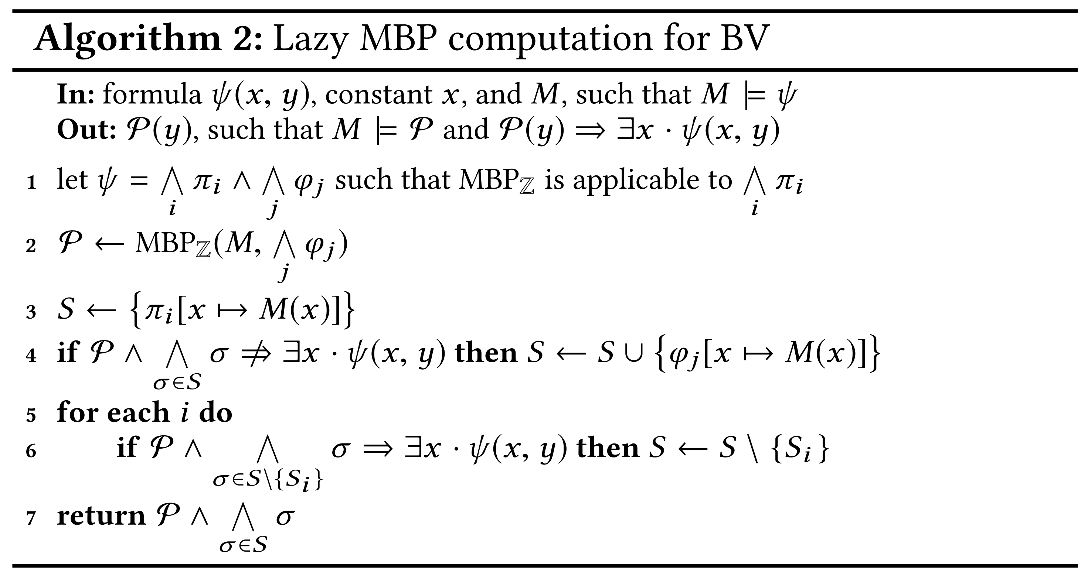
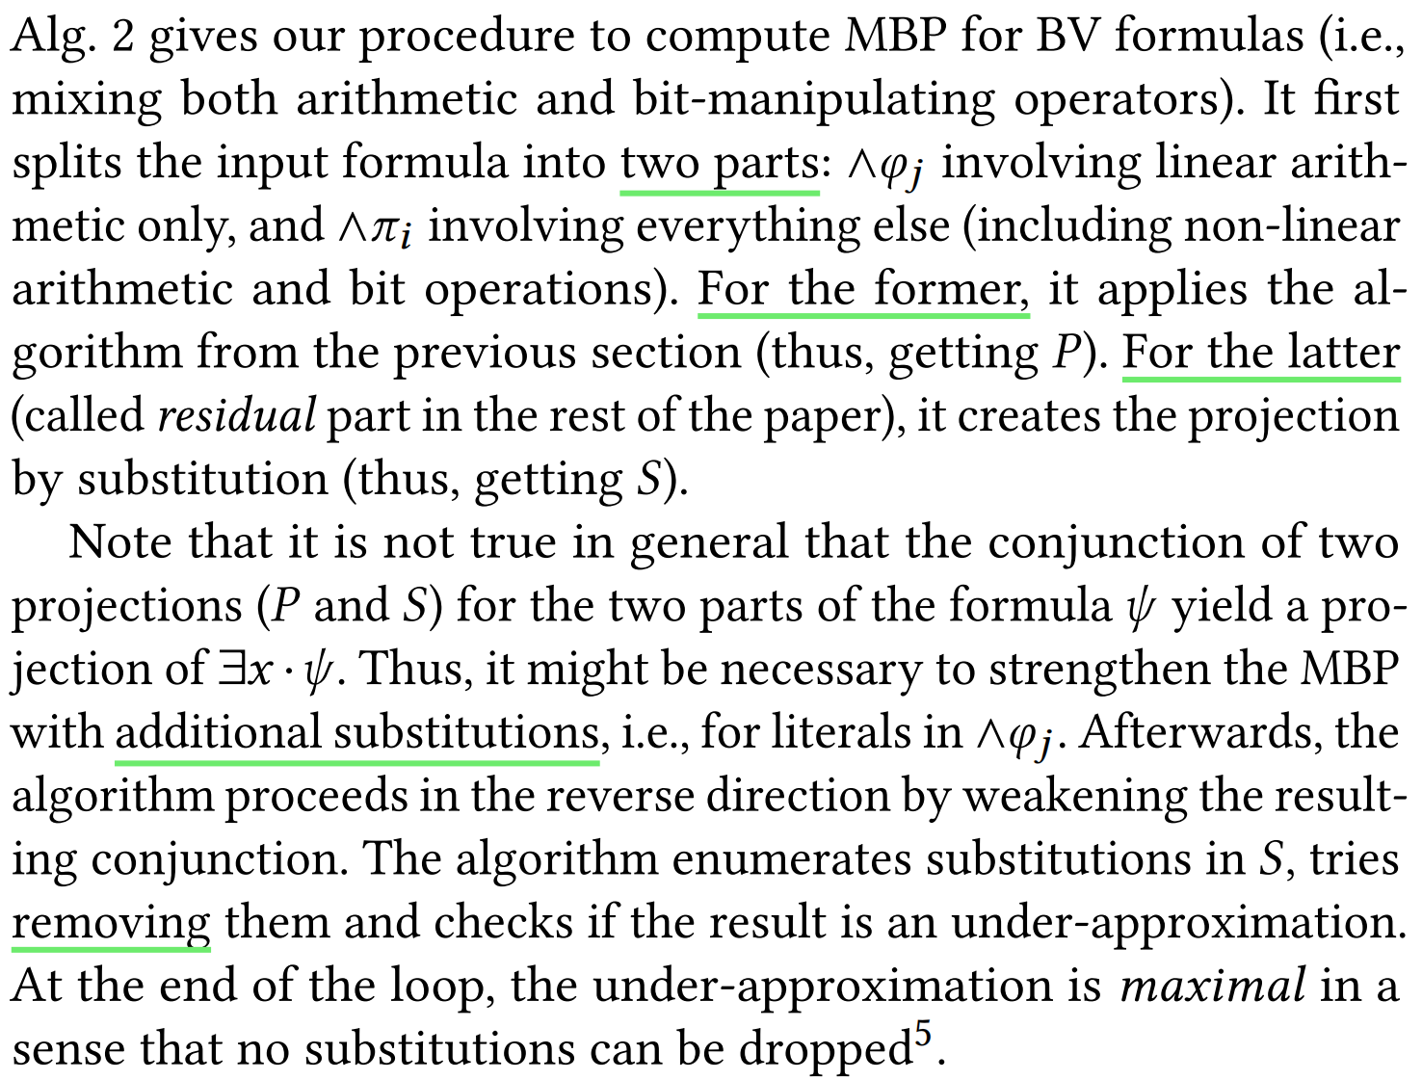
LAZY MBP FOR BV

Slide 13
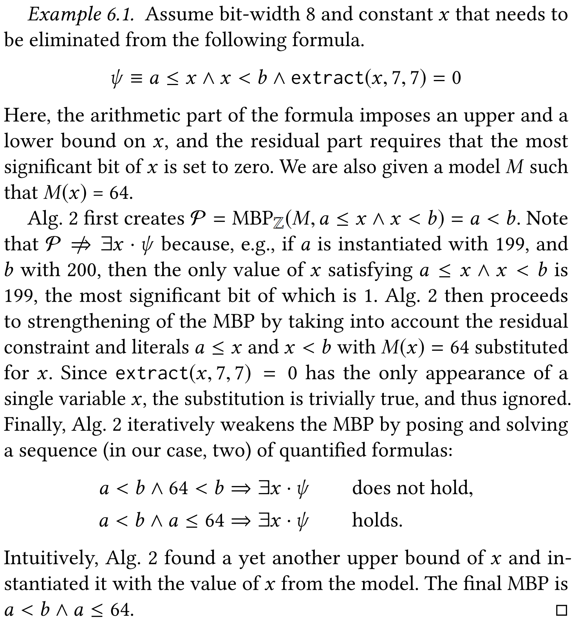
LAZY MBP FOR BV

Slide 14
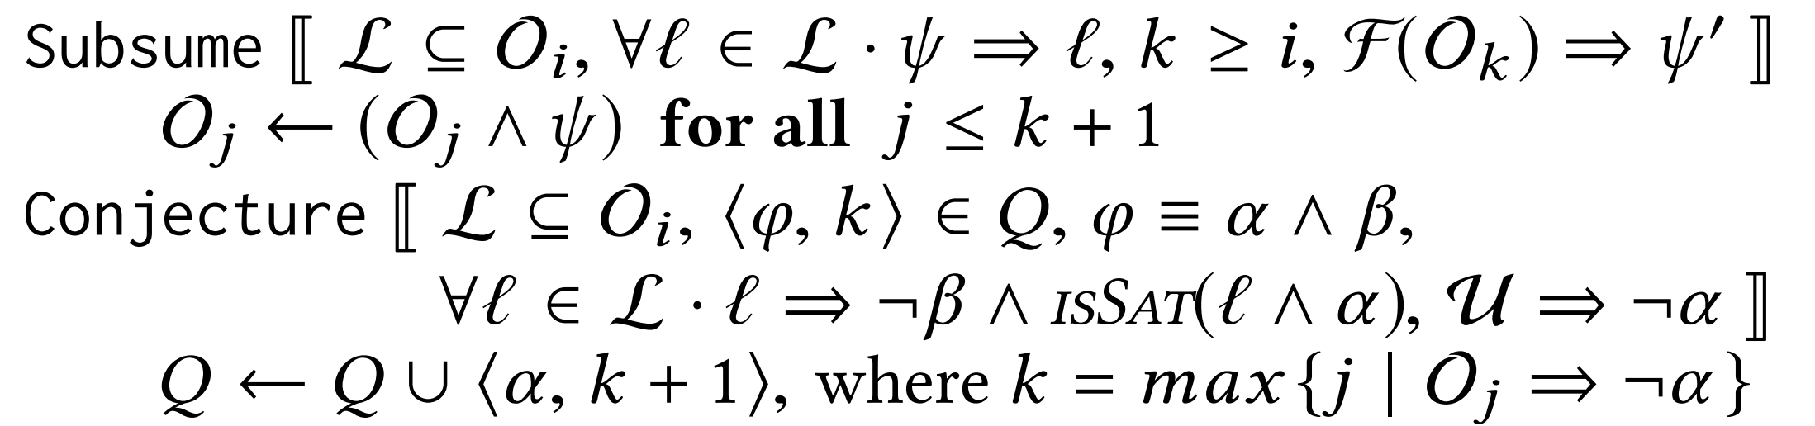
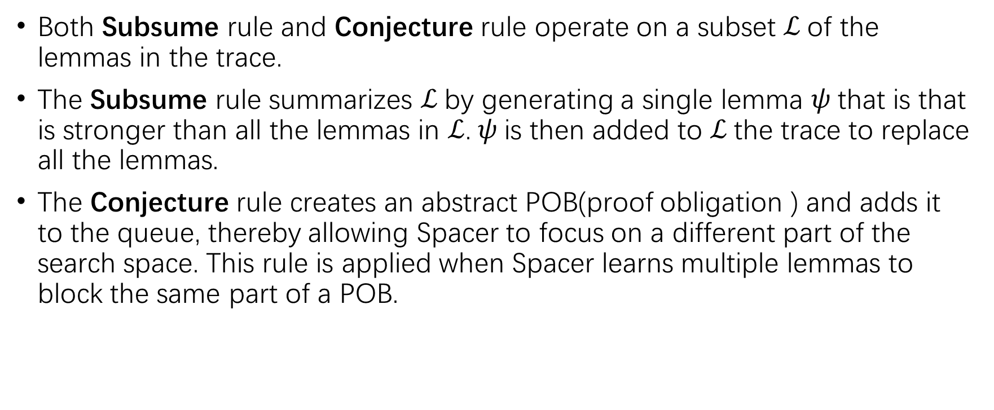
Global Guidance for Spacer: Subsume and Conjecture.
Both Subsume rule and Conjecture rule operate on a subset $ℒ$of the lemmas in the trace.
The Subsume rule summarizes $ℒ$by generating a single lemma $ψ$that is that is stronger than all the lemmas in $ℒ$.$ψ$is then added to $ℒ$the trace to replace all the lemmas.
The Conjecture rule creates an abstract POB(proof obligation ) and adds it to the queue, thereby allowing Spacer to focus on a different part of the search space. This rule is applied when Spacer learns multiple lemmas to block the same part of a POB.

Slide 15
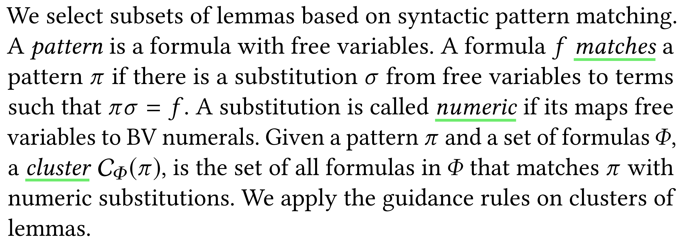
Global Guidance for BV: how to select the subset

Slide 16
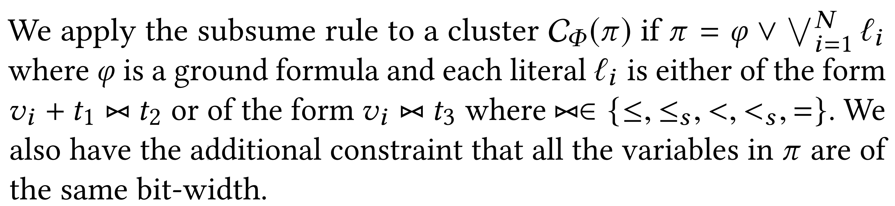
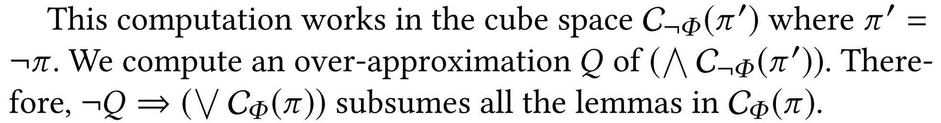
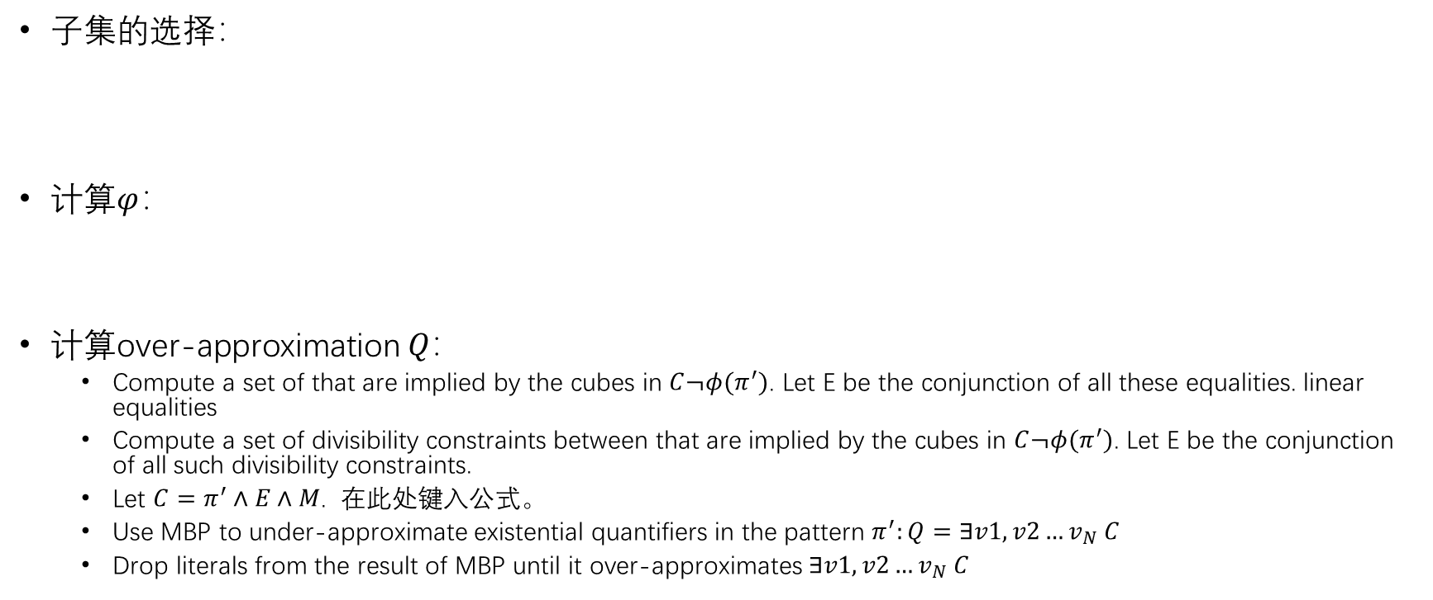
Global Guidance for BV: an instantiation of the Subsume rule
子集的选择：
计算$φ$：
计算over-approximation $Q：$
Compute a set of that are implied by the cubes in $C¬φ(π^{′})$. Let E be the conjunction of all these equalities. linear equalities
Compute a set of divisibility constraints between that are implied by the cubes in $C¬φ(π^{′})$. Let E be the conjunction of all such divisibility constraints.
Let $C=π^{′}∧E∧M$.
Use MBP to under-approximate existential quantifiers in the pattern $π^{′}:Q=∃v1,v2…v_{N} C$
Drop literals from the result of MBP until it over-approximates $∃v1,v2…v_{N} C$

Slide 17
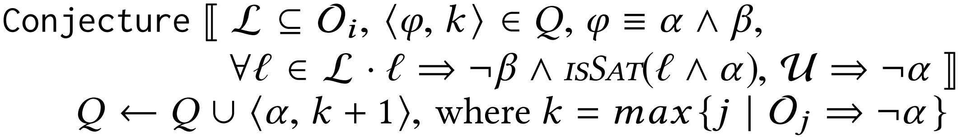
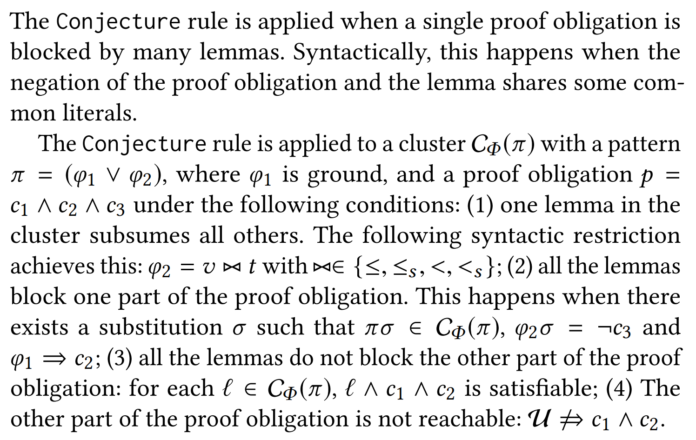
Global Guidance for BV: an instantiation of the Conjecture rule

Slide 18
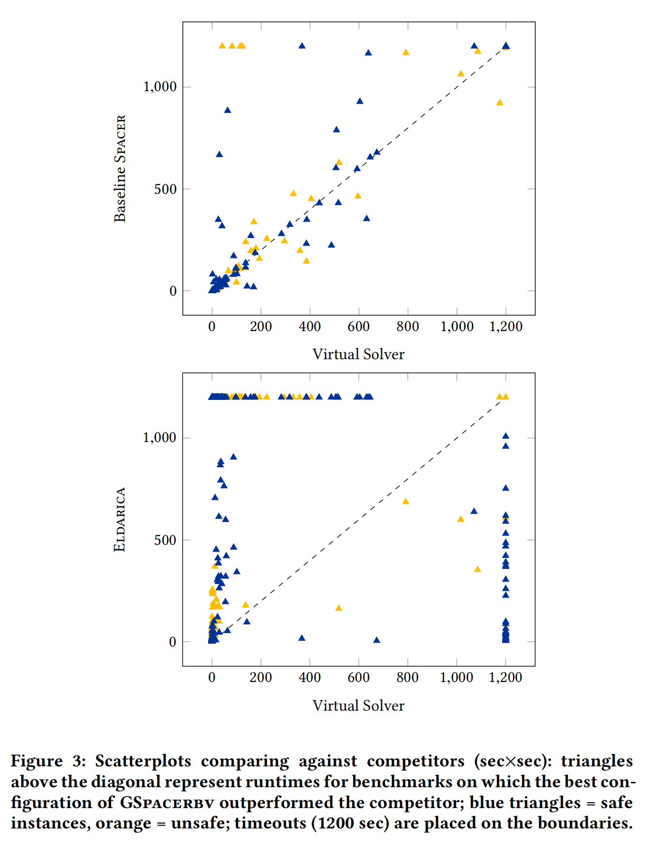
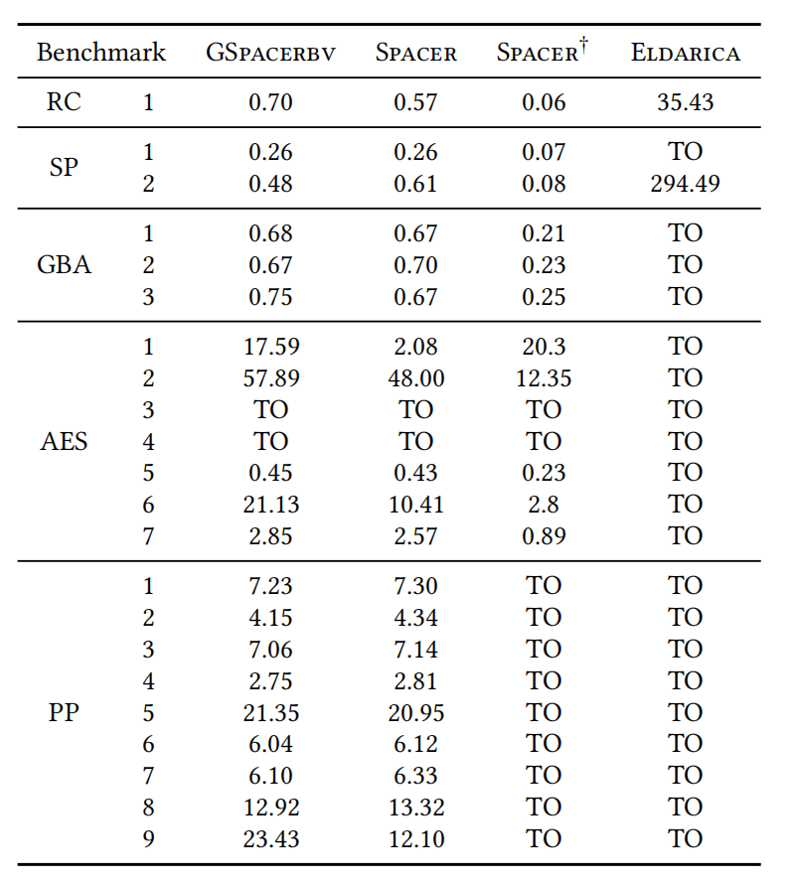
Evaluation

Slide 19
Conclusion
We proposed a less expensive method for iterative approximate quantifier elimination in BV that supports all bit-operators.
It uses recent techniques for learning inductive invariants based on explicit global guidance, thus bypassing interpolation.

